Slide 1
Understanding HTML
Chris Silk
January 2017

Slide 2
HyperText Markup Language
Understanding HTML
What is HTML?
HTML in action
Examples of good designs
Why use HTML?
Responsive designs for mobiles
What sizes?
Answers to common questions

Slide 3
What is HTML?

Slide 4
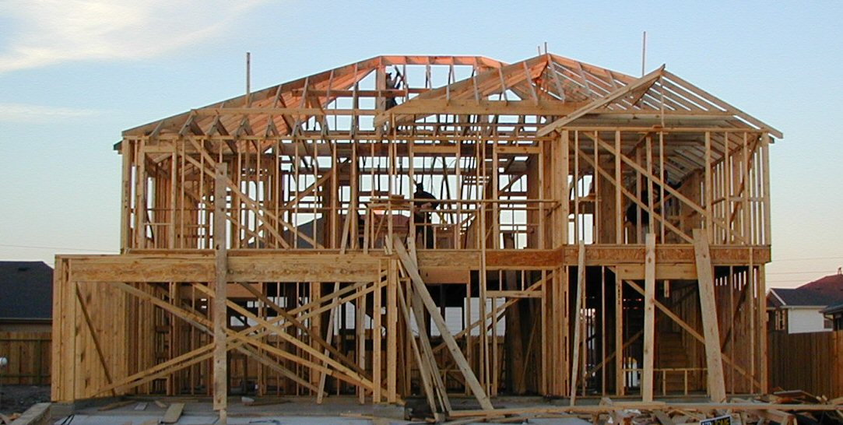
What is HTML?
HTML code determines the layout of the email we see
It forms the framework of all the emails we build. Kind of like the framework for this house! →
The HTML creates a grid structure of rows and columns, that contain all the different parts of our email

Slide 5
HTML in action

Slide 6
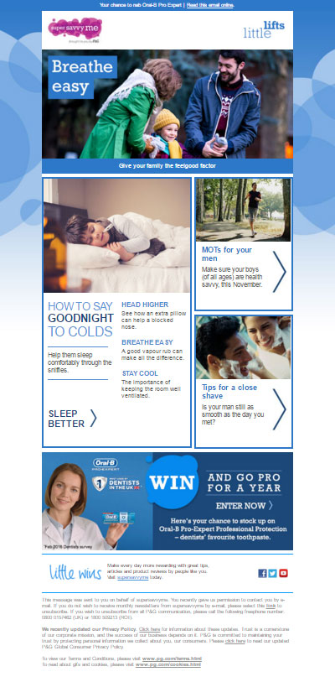

HTML in action
HTML builds a grid-like framework made up of individual cells
Each cell can have its own background colour, or can contain an image, or some text… or any combination of those
But the framework is a rigid structure – single elements must always remain within a single cell and cannot cross over between the different cells

Slide 7
Examples of good designs

Slide 8
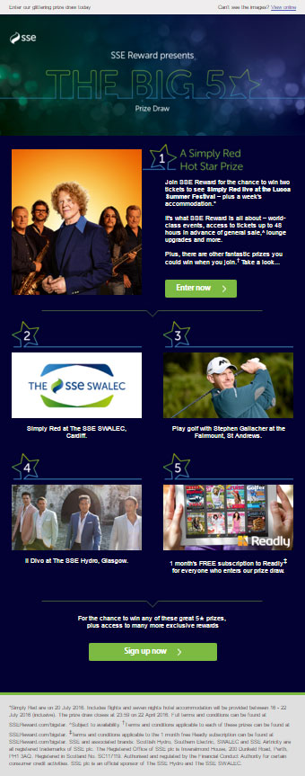
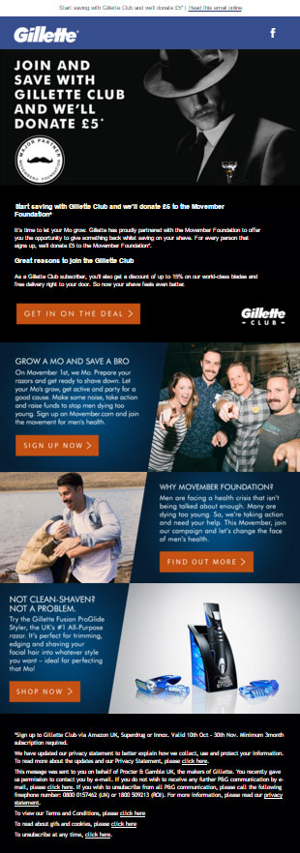
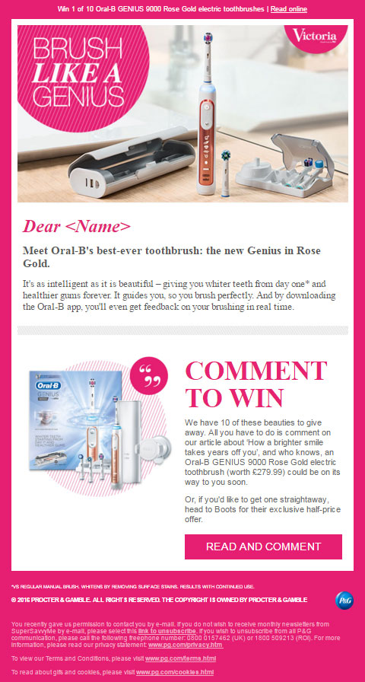
Here is a selection of emails.

Slide 9
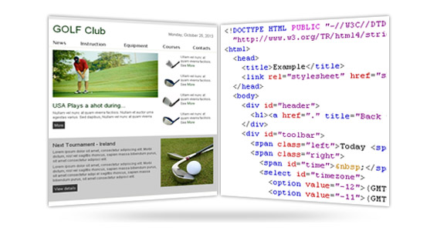
Examples of good designs
Each one of the emails has been built using HTML
Therefore, each email fits within the grid framework that has been built with HTML

Slide 10
Here are their grid structures…

Slide 11
…here’s how they fit into HTML framework.

Slide 12
Examples of good designs
The designs are loyal to the grid format that HTML uses
The different elements of the email are easily contained within their own specific cells
For example, the pictures and graphics don’t encroach into the cells already being used for text, and vice versa

Slide 13
Why use HTML?

Slide 14
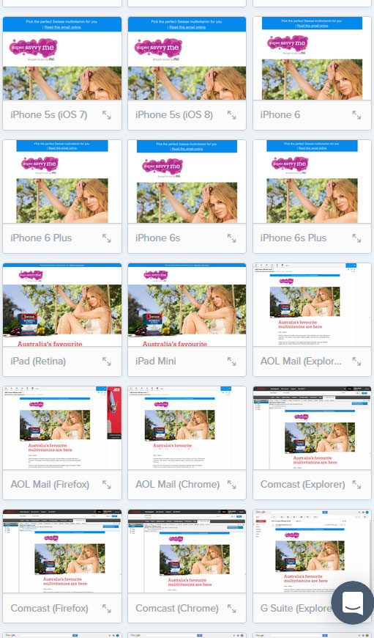
Why use HTML?
Using HTML in the way we do is actually a very old fashioned way of coding
But what we produce needs to work everywhere…
Outlook desktop, Hotmail, Yahoo, Gmail, Gmail App…
On Internet Explorer, Firefox, Chrome, Safari…
On a PC, Mac, iOS, iPad, Android… you get the idea!
So using HTML in the way we do is simply the best known way to guarantee our email will look as good as it can in as many places as it can.

Slide 15
Responsive design for mobiles

Slide 16
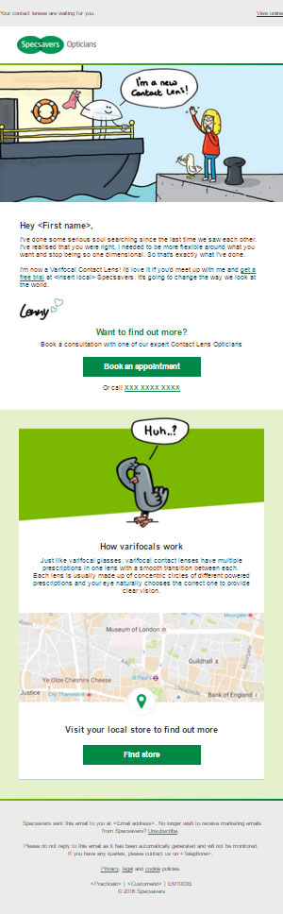
Responsive design for mobiles
Here are two email designs, and both of them are responsive designs for mobile
However, what we’re looking at here are the desktop designs...

Slide 17
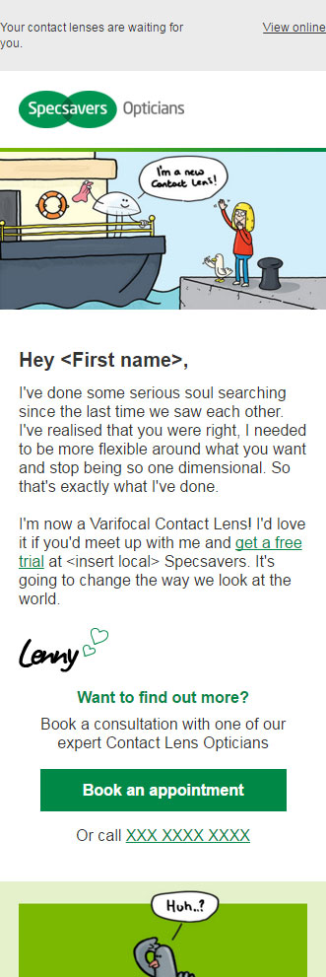
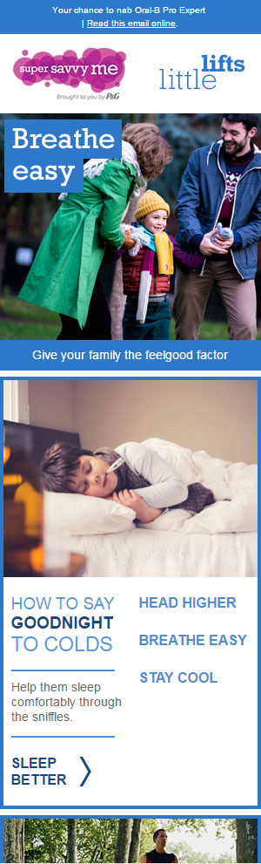
Responsive design for mobiles
…Here are the mobile designs for the same two emails (the top sections only, otherwise they’d look very tall and thin on this page!)
They are both good designs. But there are differences between the way both emails’ mobile designs differ to their desktop designs. Let’s have a closer look…

Slide 18
Responsive design 1
Desktop
Mobile
Responsive design for mobiles
Here is the first email. This has been specifically designed to transition easily between desktop and mobile view
The same images and text are used on the desktop and the mobile view
The HTML shrinks proportionally to the screen size it is viewed on

Slide 19
Responsive design 1
Desktop
Mobile
Responsive design for mobiles
Advantages:
Fewer images required, because desktop and mobile share the same ones
Therefore file sizes will be smaller for our HTML, and better for spam scores
Also faster to code and easier to amend should future changes be required
Some devices such as Windows phones, and also the Gmail App have been known to display the desktop version of an email instead of the mobile version. However, this style of coding should display as expected on these devices

Slide 20
Responsive design 1
Desktop
Mobile
Responsive design for mobiles
Disadvantages:
Less flexibility on how desktop and mobile designs differ from each other
Care needed to make sure that images, and text within images, will still be legible and look good once shrunk down to mobile screen size

Slide 21
Responsive design 2
Desktop
Mobile
Responsive design for mobiles
Here is the second email. Some of the layout and images completely change on mobile.
To do this, the HTML code will need to use “show/hide”. That is, two sections of code within the same file – one for desktop, and one for mobile. The HTML is able to decide which section of code to show, and which to hide, depending on screen size
Some of the images, such as the main image, are completely different on mobile and Desktop. So there will need to be multiple images provided.

Slide 22
Responsive design 2
Desktop
Mobile
Responsive design for mobiles
Advantages:
Much more flexibility about how your mobile design looks compared to the desktop
Ability to tailor your message to suit users by device. For example, “visit web page” link for desktop and “download the app” link for mobile users

Slide 23
Responsive design 2
Desktop
Mobile
Responsive design for mobiles
Disadvantages:
Some devices such as Windows phones or devices using the Gmail App may still display the desktop version, shrunk down to fit the screen (but will probably still display it correctly)
More images required, if desktop and mobile are using different ones
Therefore file sizes will be larger for our HTML, and not so good for spam scores
Possibly twice as much to build, and twice as much to amend if there are future changes

Slide 24
What sizes?

Slide 25
The perfect number of pixels
What sizes?
There is no set width your email has to be – but it helps to stick within certain guidelines.
Roughly speaking, a desktop email is usually about 640px wide, although anything up to about 700px shouldn’t be a problem.
But email builds take their measurements from the design – so everything needs to be pixel perfect in size:
Font sizes
Heights and widths
Gaps between images, gaps between images and text, gaps between text and CTAs, the hex codes for background colours and fonts, the height of CTAs…
Basically everything!
The look of the final product depends upon the pixel measurements in the design.

Slide 26
Desktop
What sizes?
Here is a desktop email. This one is 620px wide.
620px

Slide 27
Desktop
Mobile
What sizes?
Here is a desktop email. This one is 620px wide.
And here is the mobile version. This one is also 620px wide! Why?
Most mobile designs are intended to fit any screen width from desktop size downwards, so that when the user’s screen can no longer fit the desktop design (in this case a 620px wide email), it shrinks down.
But this still means the mobile designs, and images, must be able to display correctly at that largest size.
All you need to do is provide the mobile design at its widest possible width – in this case, 620px – and then the HTML code will take care of shrinking the design to fit any smaller screens than that.
620px
620px

Slide 28
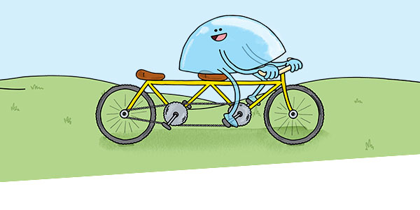
Just one thing…
What sizes?
Here is an image of a contact lens riding a bike. It will go at the top of an email that is 620px wide.
How many pixels wide will the image need to be?
It’s double what you might have expected. Why?
The answer is: retina screens.
To make images look as sharp as they can on a retina screen, the actual pixel size of the supplied image needs to be double the size at which it displays.
So the whole design needs to be provided at double the size that the email will actually be.
If we don’t do this, images just won’t look as sharp on retina screens.
1240px

Slide 29
Summing up on sizes
What sizes?
Here’s a quick rundown of what we have learned about sizes:
There are no hard and fast rules about what size your email will be.
Generally speaking a desktop email will be about 640px wide…
…And a mobile email will be the same width as the desktop, at maximum.
The HTML code takes care of scaling down the mobile version of the email, to fit any narrower screen sizes. All you need to do is provide the mobile design at the largest size it will display.
But… if you want images to look their best on a retina screen, the designs need to be provided at double these sizes.
That’s it!

Slide 30
Answers to common questions

Slide 31
Answers to common questions
Here is a selection of questions that are often asked by designers and account managers about email builds. Hopefully it will help you understand more about what’s possible and also the limitations.

Slide 32
Answers to common questions
Q: Can we use background images behind text?
A: Yes, but there needs to be plenty of ‘breathing space’ around the text, as the exact positioning of the text on top of the background image may change slightly depending on the email client being used to view it.
You also need to bear in mind that the background image will need to shrink proportionally with screen sizes on all mobiles – and the text above it will constantly need fit properly and look good at all these different sizes and widths.
Also, we need to be prepared for the background image not to work. We do this by putting a solid background colour behind the background image that would show instead. This is because we need to know that the email will still look presentable, and the text readable, if this background image fails. Blackberry devices, for example, won’t display the background image and I don’t think Silverpop supports background images at all.
This could be made into a background image
allowing text to be written across it like this!

Slide 33

Answers to common questions
Q: Can we have video in emails?
A: Yes, but sadly it will only work in a few places.
This is all about fallbacks. If the video doesn’t work, we can have an animated gif that displays instead. If the animated gif won’t show (such as in Outlook), we need to make sure the static image that displays is presentable.
Video could be worthwhile as a showpiece to impress clients, or if you know you’re targeting a lot of people who use a particular email client that displays video.
Otherwise, it’s a lot of work to set up something that only a percentage of people will see, and which could be achieved more easily by using an animated gif.
Video works well on: Apple Mail and iOS – this list might change, for better or for worse, as things get updated. You’ll need a fallback image/gif ready for everyone else.

Slide 34
Answers to common questions
Q: What size should animated GIFs be?
A: The smaller the better. Ideally an animated GIF should be below 200KB, but up to 500KB should usually be acceptable.
We need to consider mobile users who will be using up their data allowance to download large files, and slower internet connections which would prevent images loading smoothly and negating the desired effect.
There are many ways to reduce a GIF file size such as cutting frames, cropping out static parts of the image to be made into an adjoining JPEG, and selective uses of layers. All this can be done before running the file through a compression tool.
Outlook desktop users will only see the first frame as a static image, so it’s important that the first frame of the GIF works as a stand alone image.

Slide 35
Q: Which fonts can we use?
Answers to common questions
A: Ideally we need to stick to ‘web safe’ fonts. These are fonts that are generally installed by default on all computers, such as Times New Roman, Arial on PCs and Helvetica on a Mac. Therefore, we know people will see the font displaying in the way it’s meant to.
On the other hand, if the text is part of an image, then we can have any font we want because it’s just an image.
However, it’s advisable to use real, or ‘live text’, as much as possible as this helps reduce spam issues and makes the emails easier to read for users who don’t see the images. We should certainly attempt to make the majority of text within an email ‘live text’ – and so this means using web-safe fonts.
But what if a client insists on a particular, non web-safe font?
Well, we can still set this up. The way it works is that anyone, such as the client, who has this font installed on their machine will see the live text in the chosen font. However, for the majority of people who don’t have the font installed, there will be a fall-back ‘web safe’ font that will display instead – such as Arial or Times New Roman. The client needs to understand that there is nothing we can do about this.

Slide 36
Answers to common questions
Q: Can we target content to specific devices or to specific email clients?
A: With a few exceptions, we can’t do this.
It is possible to target Outlook desktop specifically (such as Outlook 2007, 2010 and 2013 etc), and it is possible to target mobile users as opposed to desktop users.
We can’t, however, do things like target specific types of phone, Android vs iOs, or Hotmail vs Yahoo vs Gmail, or anything like that… sorry!

Slide 37
Plenty is possible with your designs… so “be brave”!
Answers to common questions
Have a look at the “Tricks.html” file!
Images/CTAs that fade in and out when you hover: Yes! This can be done, but won’t work everywhere.
Images/CTAs that fade in and out automatically: Yes! Same as above. Works well for something like a flashing warning symbol, or a ‘click here’.
Text that underlines when you hover: Yes! This can be done, but won’t work everywhere.
Images that spin when you hover, or automatically: Yes! The hover and automatic spinning can both be done, but again, won’t work everywhere.
Animated loading bar: We have found a way to build an animated ‘loading bar’ into an email. It doesn’t work everywhere, but it’s a cool, eye-catching addition nonetheless. The important thing is that this is an example of a quirky idea that is possible. There will be plenty of others out there too.
Drop down menus: Another quirky, and useful, possibility. I have devised a way to do this, but it requires certain design considerations. Best to speak to me (Chris) if interested!

Slide 38
Plenty is possible with your designs… so “be brave”!
Answers to common questions
It’s still worth making things interesting.
As you can see, it’s sad that more of these things don’t work in more places. But this should not put you off.
None of these effects should break the email or spoil the user experience for recipients who don’t see the effects in action. They just won’t see the effect.
So why not let some of the users experience the jazzy effects?

Slide 39
Plenty is possible with your designs… so “be brave”!
Answers to common questions
There are restrictions in email designs, but if you don’t ask, you don’t get.
If you have an idea to make our emails stand out, suggest it. It might be possible, and it might be amazing.
On the flipside – don’t promise anything to your clients without discussing it with us first. Please!!
Have a look at the file called “Tricks.html” to see some of the things described on the previous page in action.
Then have a look at the spreadsheet called “CSS_Showcase.xlsx” which gives you an idea about where these effects will work. Bear in mind that when the effects fail, it doesn’t mean it breaks the email – it just means you won’t see the effect, and users will probably be none the wiser. So don’t let it put you off.

Slide 40
Things to have a look at
Answers to common questions
Here are two examples of pre-built emails. Please click on the links to have a look:
Username: Stage-PGE-Preview Password: &P3r50n41C4r3-7532
http://pg.proximitystage.com/emails/2016/SSM/09-11/index_v1.html http://pg.proximitystage.com/emails/2016/Victoria/Solus/Nov/oral-b/index_EN.html

Slide 41
Thank you

